Slide 1
Scrap IT Out.
Abhishek Roshan
Akshay Karvir
Nishant Soni
Shruti Kadam

Slide 2
About SCRAP-IT-OUT.
we are collecting waste scrap (Raddi) from the customer’s doorstep, within 48 hours after their registration on SCRAP IT OUT Android application.
Customer satisfaction is our main priority.

Slide 3
Features..
User friendly interface
Both options, sms and e-mail are provided for registration
Confirmation of registration is conveyed to the customer

Slide 4

Convenience Reliability User friendly

Slide 5
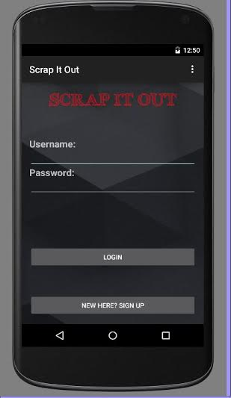
First Look..
Main frame layout.

Slide 6
Activities taking place on the main frame.
Sign Up option-For new users connecting to this application.
Login option- For those already connected to this application.
Username and the password blocks for the users connected through this application since past times.

Slide 7
Code for main frame XML file.
<RelativeLayout xmlns:android="http://schemas.android.com/apk/res/android"
xmlns:tools="http://schemas.android.com/tools"
android:layout_width="match_parent"
android:layout_height="match_parent"
android:paddingBottom="@dimen/activity_vertical_margin"
android:paddingLeft="@dimen/activity_horizontal_margin"
android:paddingRight="@dimen/activity_horizontal_margin"
android:paddingTop="@dimen/activity_vertical_margin"
android:background="@drawable/minimalbg"
tools:context=".MainActivity" >
<TextView
android:id="@+id/custom_font"
android:layout_width="wrap_content"
android:layout_height="wrap_content"
android:textSize="35sp"
android:textColor="#ffff0a18"
android:text="SCRAP IT OUT"
android:textStyle="bold"
android:textAppearance="?android:attr/textAppearanceLarge"
android:layout_alignParentTop="true"
android:layout_centerHorizontal="true" />
<TextView
<Button
android:layout_width="wrap_content"
android:layout_height="wrap_content"
android:text="New here? Sign Up"
android:id="@+id/button2"
android:onClick="start"
android:layout_alignParentBottom="true"
android:layout_alignRight="@+id/button1"
android:layout_alignEnd="@+id/button1"
android:layout_alignLeft="@+id/button1"
android:layout_alignStart="@+id/button1" />
</RelativeLayout>

Slide 8
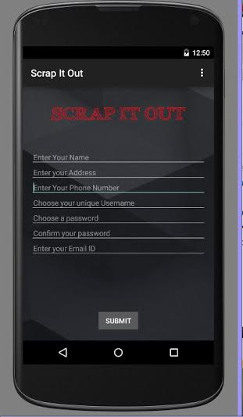
Registration Page.
Using the app for the 1st time requires the sign up process to be completed.
The registration page helps users to do this with the various options that the user needs to fill in.

Slide 9
Contents (Registration Page).
Name
Address
Phone number
Unique user name
Password
Email id

Slide 10
Xml file for Registration page..
<RelativeLayout xmlns:android="http://schemas.android.com/apk/res/android"
xmlns:tools="http://schemas.android.com/tools"
android:layout_width="match_parent"
android:layout_height="match_parent"
android:paddingBottom="@dimen/activity_vertical_margin"
android:paddingLeft="@dimen/activity_horizontal_margin"
android:paddingRight="@dimen/activity_horizontal_margin"
android:paddingTop="@dimen/activity_vertical_margin"
android:background="@drawable/minimalbg"
tools:context=".MainActivity" >
<TextView
android:id="@+id/textView1"
android:layout_width="wrap_content"
android:layout_height="wrap_content"
android:layout_alignParentTop="true"
android:layout_centerHorizontal="true"
android:textSize="35dp"
android:layout_marginTop="18dp"
android:textColor="#ffff0a18"
android:text="SCRAP IT OUT"
android:textAppearance="?android:attr/textAppearanceLarge"
style="@style/TextAppearance.AppCompat.Body1" />
<EditText
android:id="@+id/rName"
android:layout_width="wrap_content"
android:layout_height="wrap_content"
android:singleLine="true"
android:hint="Enter Your Name"
android:textColor="#999999"
android:padding="5dip"
android:textSize="15dp"
android:layout_below="@+id/textView1"
android:layout_marginTop="48dp"
android:layout_alignParentRight="true"
android:layout_alignParentEnd="true"
android:layout_alignParentLeft="true"
android:layout_alignParentStart="true">
<requestFocus/>
</EditText>

Slide 11
<EditText
android:id="@+id/rPhone"
android:layout_width="wrap_content"
android:layout_height="wrap_content"
android:singleLine="true"
android:hint="Enter Your Phone Number"
android:textColor="#999999"
android:padding="5dip"
android:textSize="15dp"
android:layout_below="@+id/rAddress"
android:layout_alignParentLeft="true"
android:layout_alignParentStart="true"
android:layout_alignRight="@+id/rAddress"
android:layout_alignEnd="@+id/rAddress">
<requestFocus/>
</EditText>
<Button
android:layout_width="wrap_content"
android:layout_height="wrap_content"
android:text="SUBMIT"
android:id="@+id/button1"
android:layout_alignParentBottom="true"
android:layout_centerHorizontal="true
<EditText
android:layout_width="wrap_content"
android:layout_height="wrap_content"
android:id="@+id/rUsername"
android:singleLine="true"
android:hint="Choose your unique Username"
android:textColor="#999999"
android:padding="5dip"
android:textSize="15dp"
android:layout_below="@+id/rPhone"
android:layout_alignParentRight="true"
android:layout_alignParentEnd="true"
android:layout_alignParentLeft="true"
android:layout_alignParentStart="true" />
<EditText
android:layout_width="wrap_content"
android:layout_height="wrap_content"
android:id="@+id/rPassword"
android:inputType="textPassword"
android:singleLine="true"
android:hint="Choose a password"
android:textColor="#999999"

Slide 12
How to implement the registration process
We will use PHP, mysql and free server provider Wampserver.
There are three parts of login and registration process:
Layout Creation
Creating activity java file
PHP API creation

Slide 13
Implementation of Navigation drawer Now a days, in most of the android applications like Facebook , Google plus ,you tube, amazon kindle , true caller .. etc you have seen a side menu which appears on click of an icon on top left corner or by dragging on to the screen from left to right . So, in our app we are using navigation drawer to access various features of it.

Slide 14
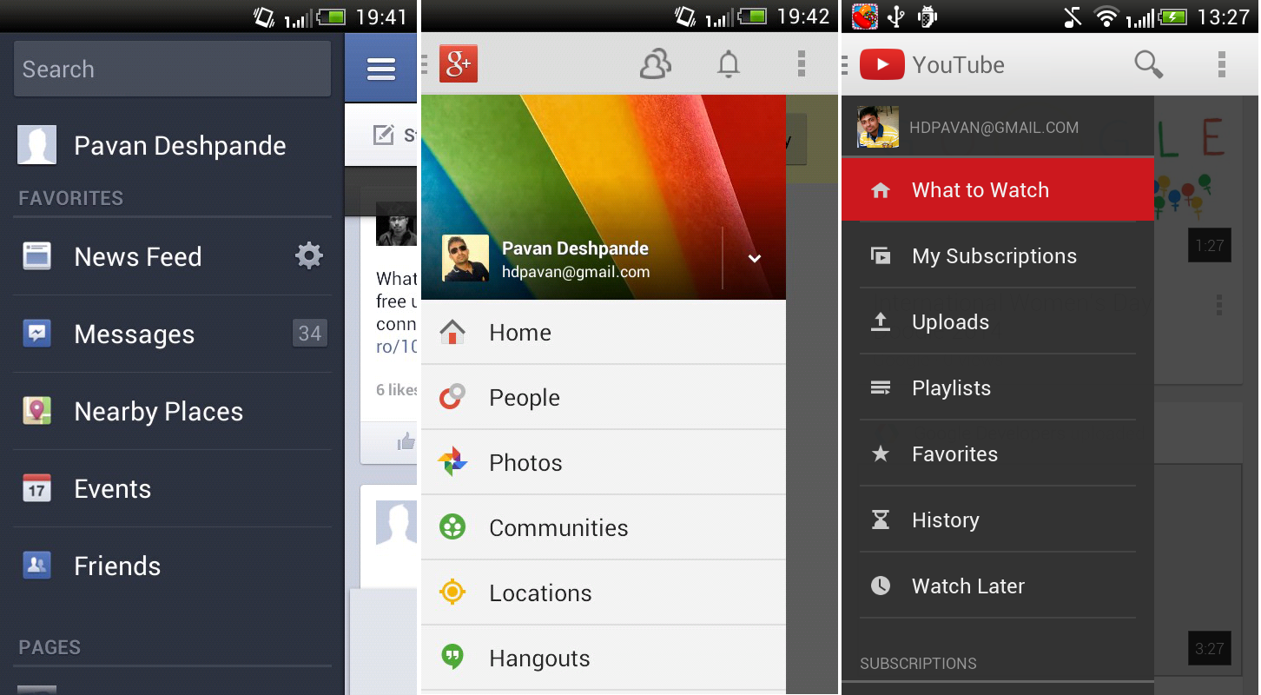

Slide 15
Thank You..

